Slide 1
STEPS TO SET UP ENVIRONMENT FOR AUTOMATION
INSTALL JAVA
INSTALL ECLIPSE
CRATE MAVEN PROJECT

Slide 2
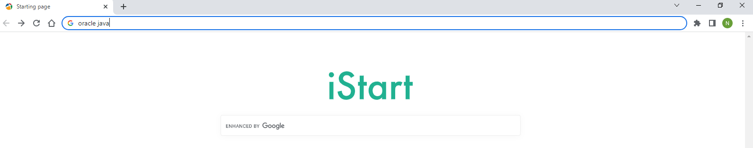
HOW TO INSTALL JAVA
Step 1:- Use any browser and type in oracle java press enter.

Slide 3
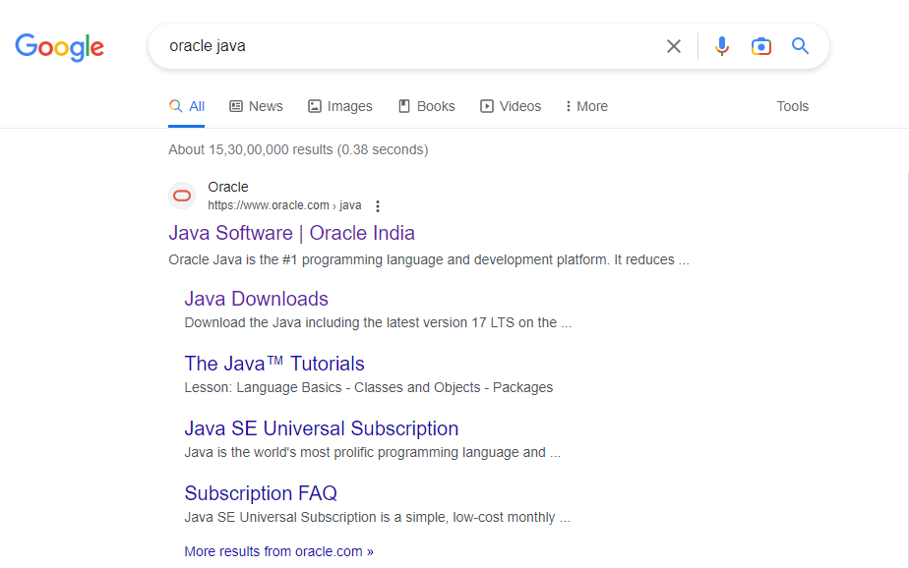
Step 2:-click on the official website of the oracle to open it.
https://www.oracle.com/in/java/

Slide 4
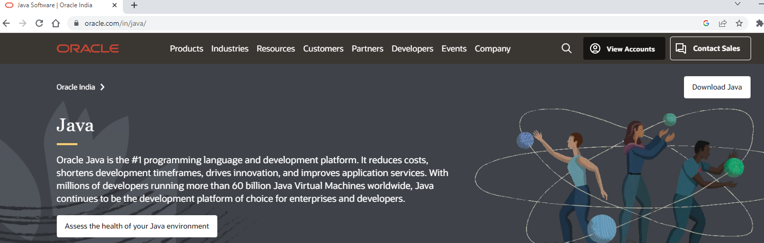
Step 3:- click on the Download java button which is found on the right corner of the page.

Slide 5
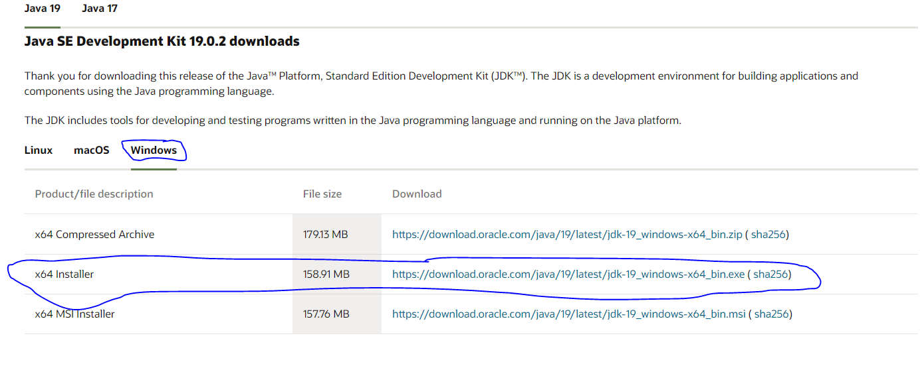
Step 4:- scroll down the page and click on the windows for downloading java for windows
Click on the java installer link to download java.

Slide 6
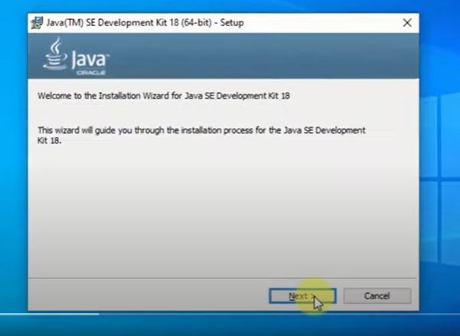
Step 5:- once you click on the link file will start to download and after the download of file double click on the file to install.
Click on the next button.

Slide 7
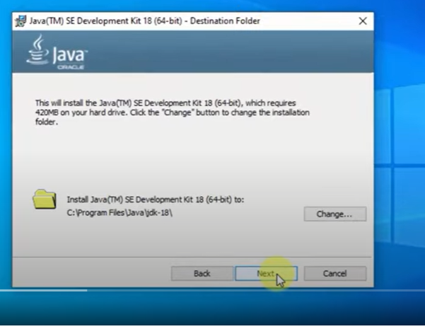
Step 6:- click on the next button.

Slide 8
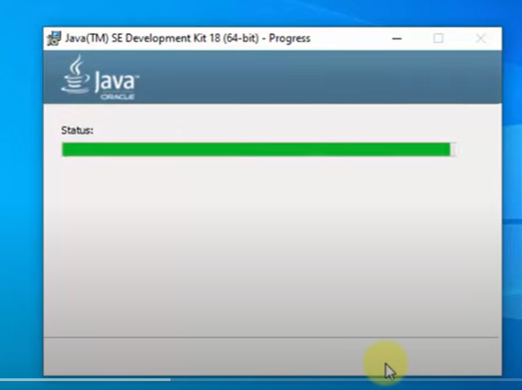
Step 7:- The installation process will start

Slide 9
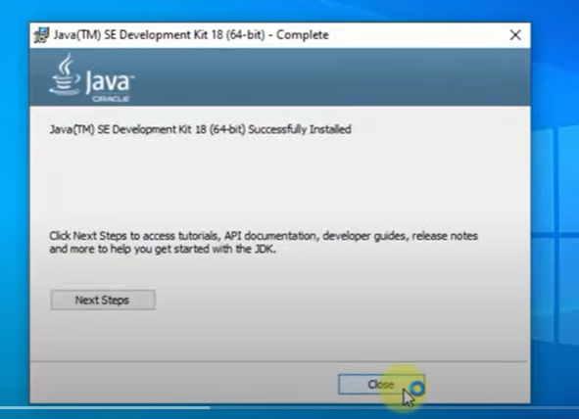
Step 8:- we have successfully installed and press on the close button.

Slide 10
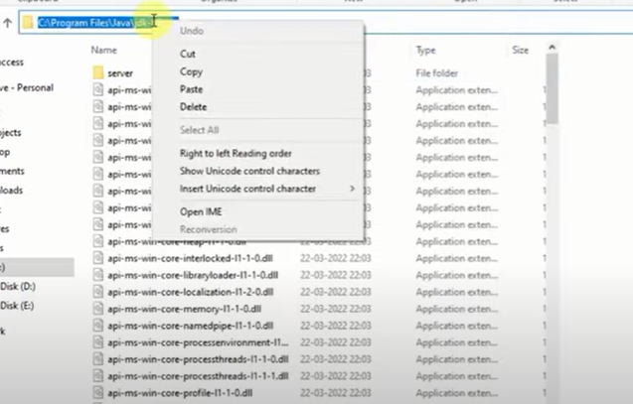
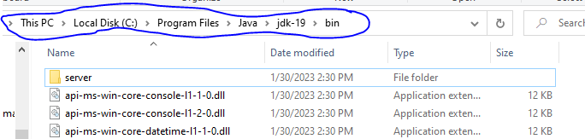
Step 9 :- set path in the environment variable.
Copy the location of the java file .
Goto-> this pc->local disk(c)->program files->java->bin right click and copy the path.

Slide 11
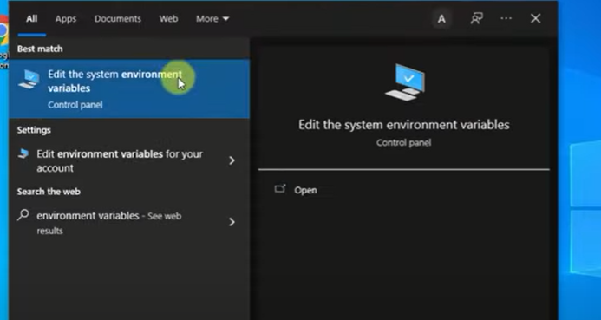
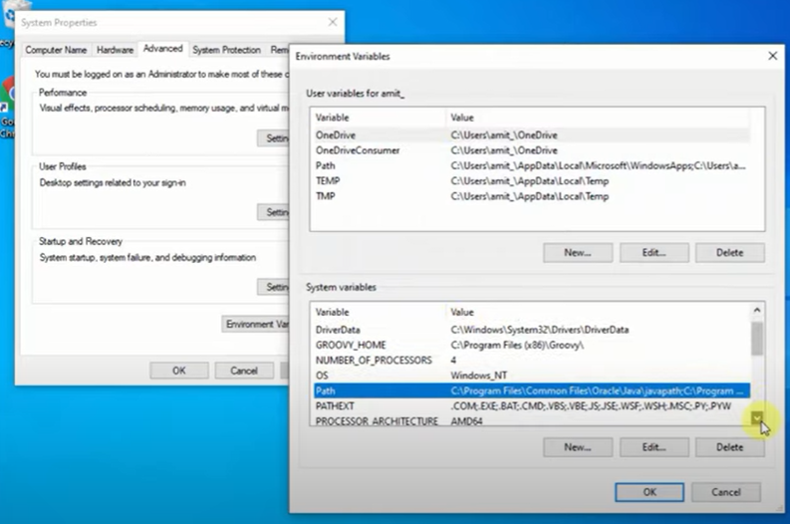
Step 10:- Go to start type system environment variables and open it , click on the environment variables

Slide 12
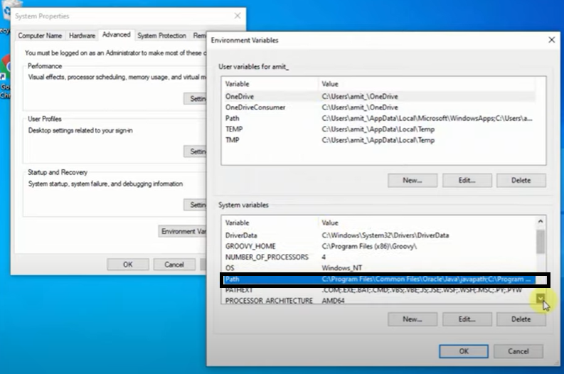
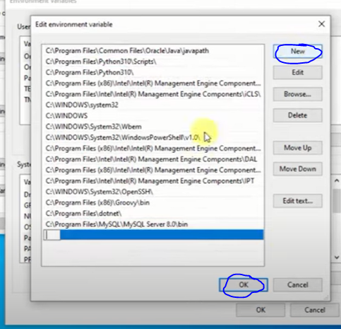
Step 11:- double click on the path ,click on the new and paste the path which you have copied
Click on the ok.

Slide 13
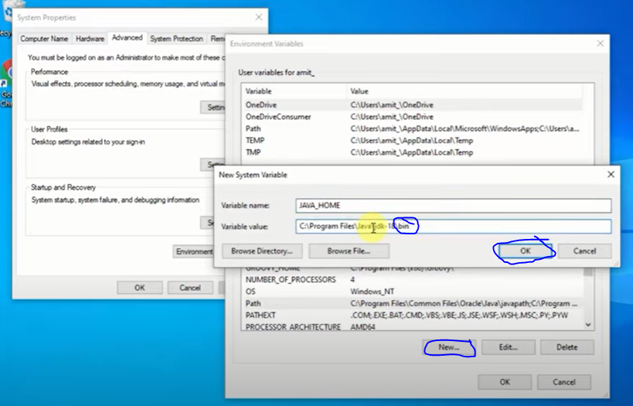
Step 12:- click on the new and here we set another path , under variable name type JAVA_HOME, and under variable value paste the same path but remove the bin which is at end and click ok.

